Slide 1

BANK CUSTOMER SEGMENTAION ANALYSIS
PRESENTED BY :
NAME : Smaily Pandit Fulzele
BATCH No. : 517

Slide 2
ABOUT ME
I Am SMAILY PANDIT FULZELE.
I have completed my Graduation and Post Graduation in Chemistry. With a strong interest in analytical thinking, problem- solving, and working with data, I choose to transition into the field of Data Analytics.
Linkdln :
GitHub :

Slide 3
Agenda
Introduction
Problem Statement
Objective
Data Source
Steps For Collecting The Data
Data Cleaning
Dashboard Overview
Key Insights
Summary
Business Recommendation
Conclusion
Q&A

Slide 4
Introduction
The banking sector generates extensive customer, demographic, and transaction data, which can be leveraged to understand customer need and business performance.
This project uses Power BI to analyze customer profiles, transaction patterns, customer value, and behavioural trends through interactive dashboards and visualizations.
The analysis covers Customer Demographic Analysis, Transaction Behavior Insights, Customer segmentation, and profitability and Risk Indicators.
Demographic analysis provides insights into the age, gender, locations and customer profile, while transaction analysis identifies patterns in transaction frequency, amount, timing and activity.
Customer segmentation helps classify customers based on their recency, frequency, monetary value, engagement and loyalty, enabling better understanding of different customer groups.
Profitability and risk indicators further helps identify high-value customers, profitable segments and customers requiring greater attention.
Overall, the project transforms raw banking data into meaningful, interactive, and actionable insights that can support customer retention, targeted marketing, risk management, and data- driven business decision.

Slide 5
Problem Statement
The Challenge :
Banks generate large volumes of customer and transaction data, but extracting meaningful business insights from this data can be challenging.
Key Problems :
Limited understanding of customer demographics and profiles.
Difficulty identifying transaction behaviour and spending patterns.
Lack of effective customer segmentation based on value and engagement.
Challenges in identifying high-value, inactive, and potentially risky customers.
Difficulty measuring customer profitability and risk indicators.
To leverage Power BI and data analytics to transform raw banking data into interactive, actionable insights that support customer targeting, retention, profitability, risk management and data-driven decision- making.

Slide 6
Objective
Primary objective :
To use Power BI and Data analytics to understand customer behaviour, identify valuable customer segments and generate actionable banking insights.
Key Objectives :
Analyze Customer Demographics to understand customer distribution across age, gender, location and other demographic attributes.
Analyze Transaction Behaviour to identify patterns in transaction volume, frequency, amount, timing and spending behaviour.
Perform customer segmentation to categorize customers based on recency, frequency, monetary value, engagement and loyalty.
Evaluate Profitability to analyze the contribution of different customers and segments to revenue and profitability.
Assess risk indicators to identify high risky or less-engaged customer segments requiring attention .
Develop on interactive Dashboard to create a user friendly Power BI dashboard with KPIs, filters and meaningful visualization.
Generate Actionable insights to support customer retention, targeted marketing, profitability improvement and informed business decisions.

Slide 7
Data Source
Source of Data :
The project uses bank_transactions dataset.
Data Description :
TransactionID : Unique ID assigned to each individual transaction.
CustomerID : Identifier linking each transaction to a specific customer.
CustomerDOB : Date of birth of customer, useful for calculating age.
CustGender : Gender of the customer (e.g., Male, Female).
CustLocation : Geographic location or city of the customer.
CustAccountBalace : Account balance at the time of the transaction.
TransactionDate : The date when the transaction occurred.
TransactionTime : The exact time when transaction was executed.
TranscationAmount(INR) : The amount of money involved in transaction in INR.

Slide 8
Steps For Collecting The Data
1. Identify the Data Source :
The Dataset was sourced from bank transactions containing TransactionID, CustomerID, CustomerDOB, CustGender, CustLocation, CustAccountBalance, TransactionTime, TransactionDate, TransactionAmount (INR).
2. Collect the Dataset :
Collected the required data in a structured format such as CSV or Excel for further analysis.
3. Review the Data :
Examined the dataset columns, data types, missing values, duplicates, and inconsistencies.
4. Clean and Prepare the Data :
Removed duplicates, handled missing or incorrect values, standardized formats and prepared the data for analysis.
5. Transform the Data :
Created required calculated columns, measures, KPIs, and customer segments attributes.
6. Load into Power BI :
Imported the prepared dataset into Power BI and established the required relationships between tables.
7. Analyze and Visualize :
Created interactive dashboards and analysed customer demographics, transaction behavior, customer segments, profitability and risk indicators.

Slide 9
Data Cleaning
Checked and Fixed missing values in columns like CustomerDOB.
Removed duplicate records from entire column.
Corrected data types in CustomerDOB, TransactionTime.
Maintained consistent formats for dates, times, categorical values and numerical fields.
Checked for invalid values and replaced it with null in CustomerDOB.
The Cleaned dataset was finalized and loaded into Power BI for further transformation, analysis and visualization.

Slide 10
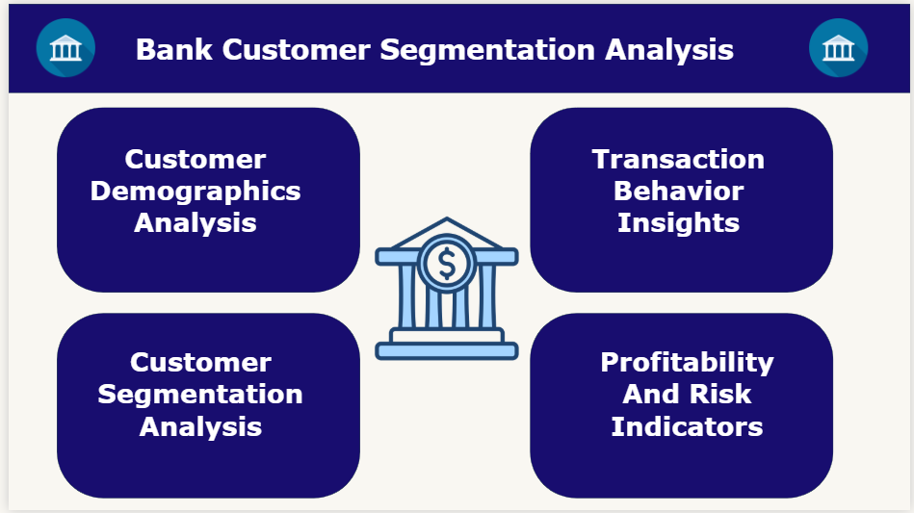
Dashboard Overview
Dashboard Components :
Customer Demographics Analysis :
Presented customer distribution by age, gender, location and other demographic characteristics.
Transaction Behavior Insights :
Visualized transaction volume, highest single transaction amount, frequency, timing and activity patterns.
Customer Segmentation Analysis :
Classified customers into meaningful segments based on recency, monetary, frequency value such as New, loyal, Lost customers.
Profitability and Risk Indicators :
Highlighted revenue contribution based on risk indicators, visualized high risk customers.
This dashboard was designed to provide a comprehensive view of Customer behaviour, value, profitability, and risk through interactive visualizations.

Slide 11
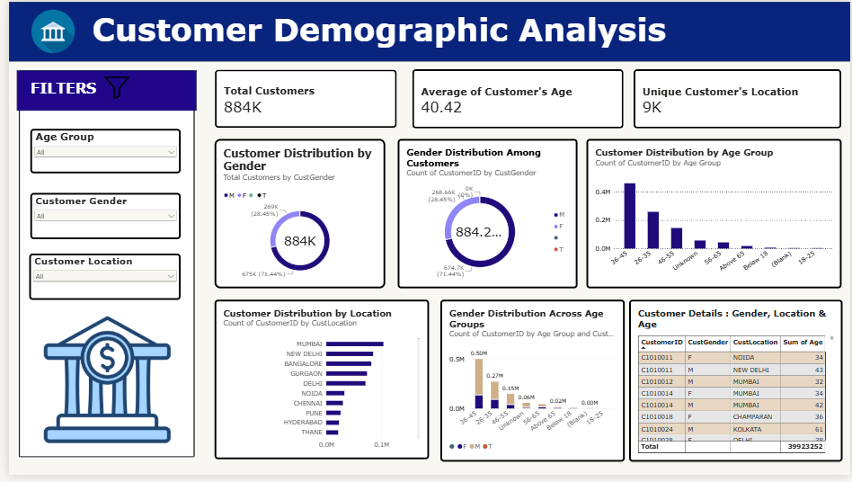
1. Customer Demographics Analysis

Slide 12
Key Insights
884K customers were analyzed, with an average customer age of 40.42 years, indicating a predominantly mature customer base.
Male customers form the largest customer group, accounting for approximately 71.5% of the total customer base, while female represent around 28.5%.
The 36-45 age group has the highest customer concentration, followed by 26-35 age group, showing strong representation among working-age customers.
Customer distribution is geographically concentrated, with Mumbai, New Delhi, Banglore, Gurgaon and Delhi emerging as the leading customer locations.
The gender distribution varies across age groups, providing opportunities to design more targeted products and marketing strategies.
The presence of customers across multiple age groups and locations indicates a diverse customer base that can be further segmented for personalized banking services.

Slide 13
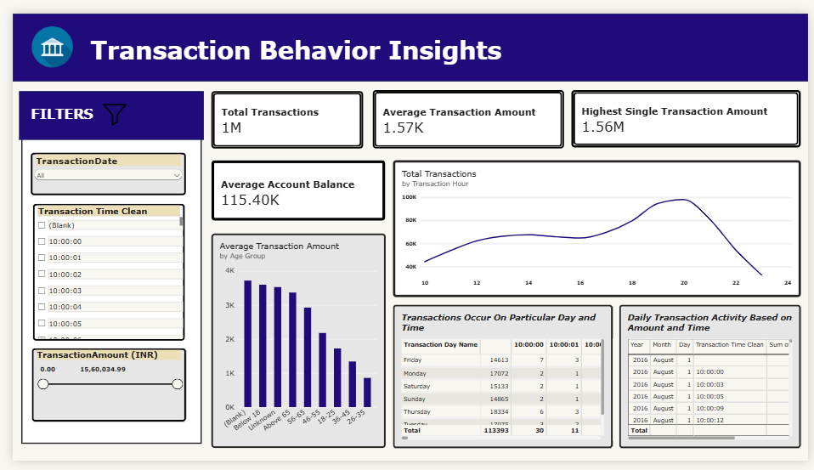
2. Transaction Behaviour Insights

Slide 14
Key Insights
The dashboard records approximately 1 million transactions, indicating stronger customer activity.
The average transaction amount is 1.57K, suggesting most transactions are relatively moderate in value.
The highest single transaction is 1.56M, indicating the presence of a few very high-value transactions that may require monitoring.
The average account balance is 115.40K, which is substantially higher than the average transaction amount.
Transaction activity rises during the day and reaches its highest level around 19:00-20:00, before declining sharply later in the evening.
The chart shows higher average transaction amounts among younger age groups, with the average declining across the older age groups.
Transaction volumes differ across weekdays, with Thursday appearing particularly active in the displayed summary.

Slide 15
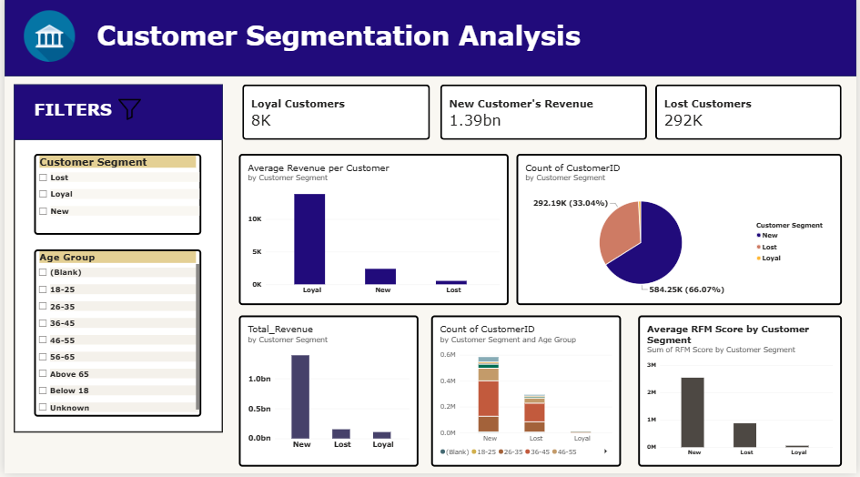
3. Customer Segmentation Analysis

Slide 16
Key Insights
Around 8K loyal customers are identified, representing a smaller but valuable customer segment.
New customers generate approximately 1.39B, making them the largest revenue-contributing segment.
Approximately 292K customers are classified as lost, representing a significant opportunity for customer retention and reactivation.
Loyal customers have highest average revenue per customer, while lost customers contribute least on average.
There are 66.07% new customers which is the larger segment and 33.04% lost customers which is the other major segment, highlighting uneven customer distribution.
The customer base is spread across multiple age groups, with the 18-25 and 26-35 groups forming a substantial portion of the displayed customer counts.
New customers have the highest overall RFM score, followed by lost customers show a comparatively lower displayed RFM total.

Slide 17
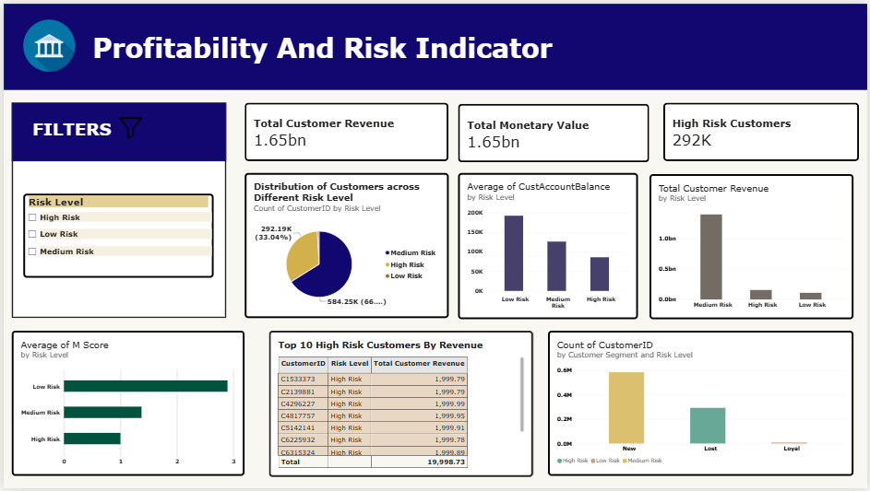
4. Profitability and Risk Indicator

Slide 18
Key Insights
Approximately 1.65B, showing strong overall revenue generation.
Around 292K customers are classified as high risk, making customer risk management a major concern.
The majority of customers appear to fall into the medium-risk category (584K), while high-risk customers account for roughly 292K.
Low risk customers have the highest average account balance, followed by medium-risk and high-risk customers.
Medium risk customers contribute the largest share of total customer revenue, significantly higher that high and low risk groups.
Low risk customers have the highest average M score, while the high-risk customers have the lowest, indicting weaker monetary value behaviour among high-risk customers.
The top high risk customers each generate close to 2,000 in customer revenue, with the top 10 contributing amount 19,998.73 collectively

Slide 19
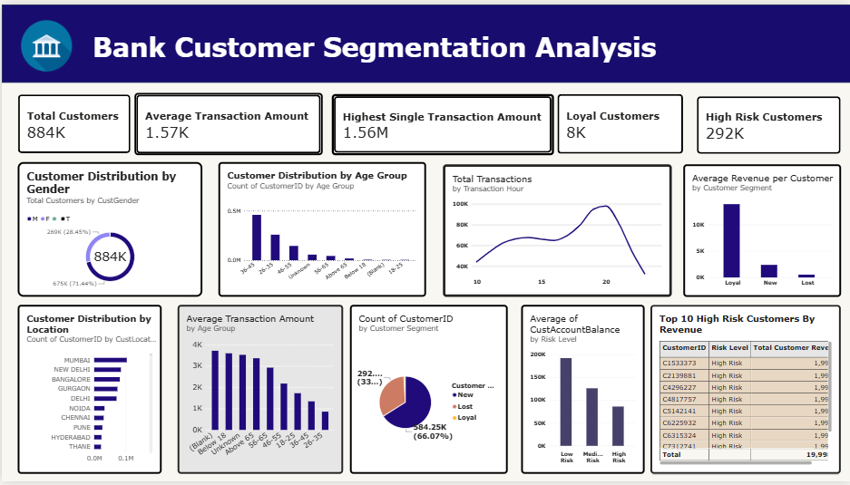
Overall Summary

Slide 20
Key Insights
884K customers were analyzed, with an average customer age of 40.42 years, indicating a predominantly mature customer base.
The average transaction amount is 1.57K, suggesting most transactions are relatively moderate in value.
The highest single transaction is 1.56M, indicating the presence of a few very high-value transactions that may require monitoring.
Around 8K loyal customers are identified, representing a smaller but valuable customer segment.
Around 292K customers are classified as high risk, making customer risk management a major concern.
Male customers form the largest customer group, accounting for approximately 71.5% of the total customer base, while female represent around 28.5%.
The 36-45 age group has the highest customer concentration, followed by 26-35 age group, showing strong representation among working-age customers.

Slide 21
Transaction activity rises during the day and reaches its highest level around 19:00-20:00, before declining sharply later in the evening.
Loyal customers have highest average revenue per customer, while lost customers contribute least on average.
Customer distribution is geographically concentrated, with Mumbai, New Delhi, Banglore, Gurgaon and Delhi emerging as the leading customer locations.
The chart shows higher average transaction amounts among younger age groups, with the average declining across the older age groups.
There are 66.07% new customers which is the larger segment and 33.04% lost customers which is the other major segment, highlighting uneven customer distribution.
Low risk customers have the highest average account balance, followed by medium-risk and high-risk customers.
The top high risk customers each generate close to 2,000 in customer revenue, with the top 10 contributing abount 19,998.73 collectively.

Slide 22
Business Recommendation
Design targeted banking products and offers based on age, gender, location, transaction behaviour and customer segment.
Provide loyalty benefits, personalized communication, and exclusive services to retain high value and loyal customers.
Identify lost or low-engagement customers and use targeted campaigns, special offers, and digital communication to encourage them to return.
Promote relevant products such as credit cards, loans, investments, and savings plans to customers with strong transaction activity and financial potential.
Prioritize customers showing increasing transaction frequency, monetary value, or engagement and develop strategies to move them toward higher-value segments.
Monitor customers and segments with higher risk indicators and apply appropriate monitoring, verification and risk control measures.
Focus marketing and branch on high-customer-concentration locations while identifying opportunities in underrepresented regions.
Use the Power BI dashboards regularly to monitor KPIs, customer movement between segments, profitability and risk trends for timely business decisions.

Slide 23
Conclusion
The analysis identified key customer demographic patterns, including age, gender and location distribution.
Transaction analysis revealed important patterns in transaction value, frequency, and timing.
Customer segmentation helped distinguish between New, Loyal and Lost customers enabling more targeted strategies.
The analysis highlighted the importance of focusing on high values customers while improving engagement with less-active customers.
Risk analysis identified a significant high-risk customer base, emphasizing the need for continuous monitoring and effective risk management.
The Power BI dashboard brought these insights together through interactive KPIs, charts, filters, and detailed visualizations.

Slide 24

Any
Questions

Slide 25

THANK YOU

